Slide 1
NFL Super Bowl Study Group 4
Luis Cerrilla
John Dilligard
Will Pumphrey
Cale Wallace

Slide 2
Appendix
Conclusions
Dataset limitations
Possible tables and/or graphs

Slide 3
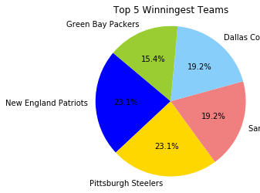
Conclusions
New England Patriots and Pittsburg Stealers are the teams with more Superbowl’s Championships with six each one.

Slide 4
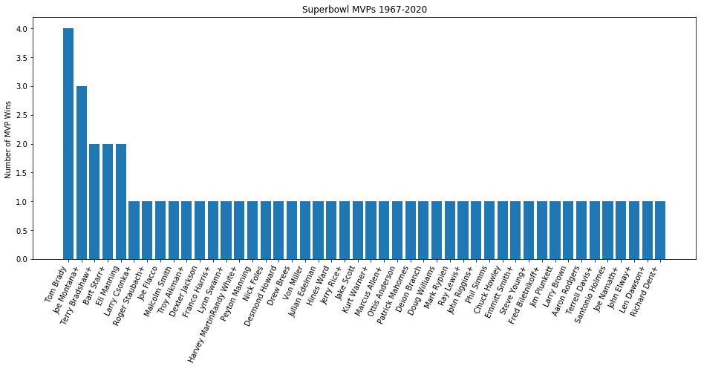
Conclusions
Tom Brady has been the player with most MVPs

Slide 5
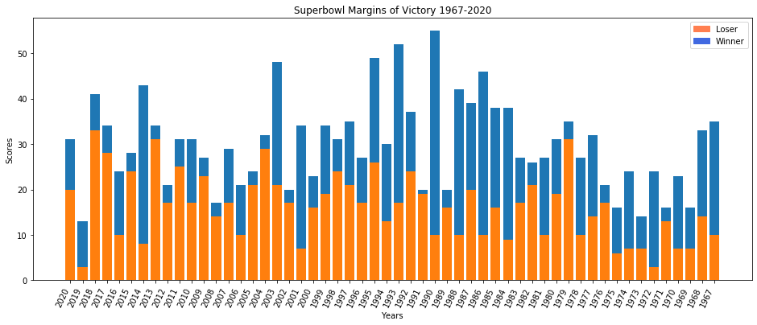
Conclusions
The margins of Superbowl's has increase over the years

Slide 6
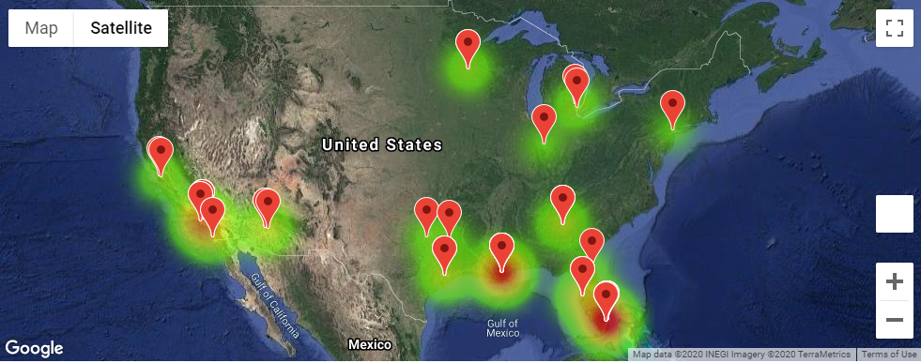
Conclusions
Mimi is the city with more Superbowl’s, and most of them have been on the south of the country.

Slide 7
#How many points do you need to win a Super Bowl?
#How many points the winners scored?

Slide 8
Limitations
The dataset was very limited, it only contains the basic information about Superbowl’s. We consider we could make a deeper analysis with more statistics.
53 rows, one for each Superbowl
10 columns of data/statistics

Slide 9
Possible tables and/or graphs
We could have made beans for different time periods and compare how Superbowl's have change threw the years.

